Slide 1
Responsive Prayer
God of Holy Dreaming, Great Creator Spirit, from the dawn of creation you have given your children the good things of Mother Earth.
You spoke and the gum tree grew.
In the vast desert and the dense forest, and in the cities and at the water’s edge, creation sings your praises.
Your presence endures as the rock at the heart of our Land.

Slide 2
When Jesus hung on the tree you heard the cries of all your people and became one with your wounded ones: the convicts, the hunted, and the dispossessed.
The sunrise of your Son coloured the earth anew, and bathed it in glorious hope.

Slide 3
In Jesus we have been reconciled to you, to each other and to your whole creation.
Lead us on, Great Spirit, as we gather from the four corners of the earth; enable us to walk together in trust from the hurt and shame of the past into the full day which has dawned in Jesus Christ.
Amen.

Slide 4
Preamble to Uniting Church Constitution
As the Uniting Church believes God guided it into union so it believes that God is calling it to continually seek a renewal of its life as a community of First Peoples and of Second Peoples from many lands, and as part of that to recognise that:

Slide 5
When the churches that formed the Uniting Church arrived in Australia
as part of the process of colonisation they entered a land that had been created and sustained by the Triune God they knew in Jesus Christ.

Slide 6
2. Through this land God had nurtured and sustained the First Peoples of this country, the Aboriginal and Islander peoples, who continue to understand themselves to be the traditional owners and custodians (meaning 'sovereign' in the languages of the First Peoples) of these lands and waters since time immemorial.

Slide 7
3. The First Peoples had already encountered the Creator God before the arrival of the colonisers; the Spirit was already in the land revealing God to the people through law, custom and ceremony. The same love and grace that was finally and fully revealed in Jesus Christ sustained the First Peoples and gave them particular insights into God's ways.

Slide 8
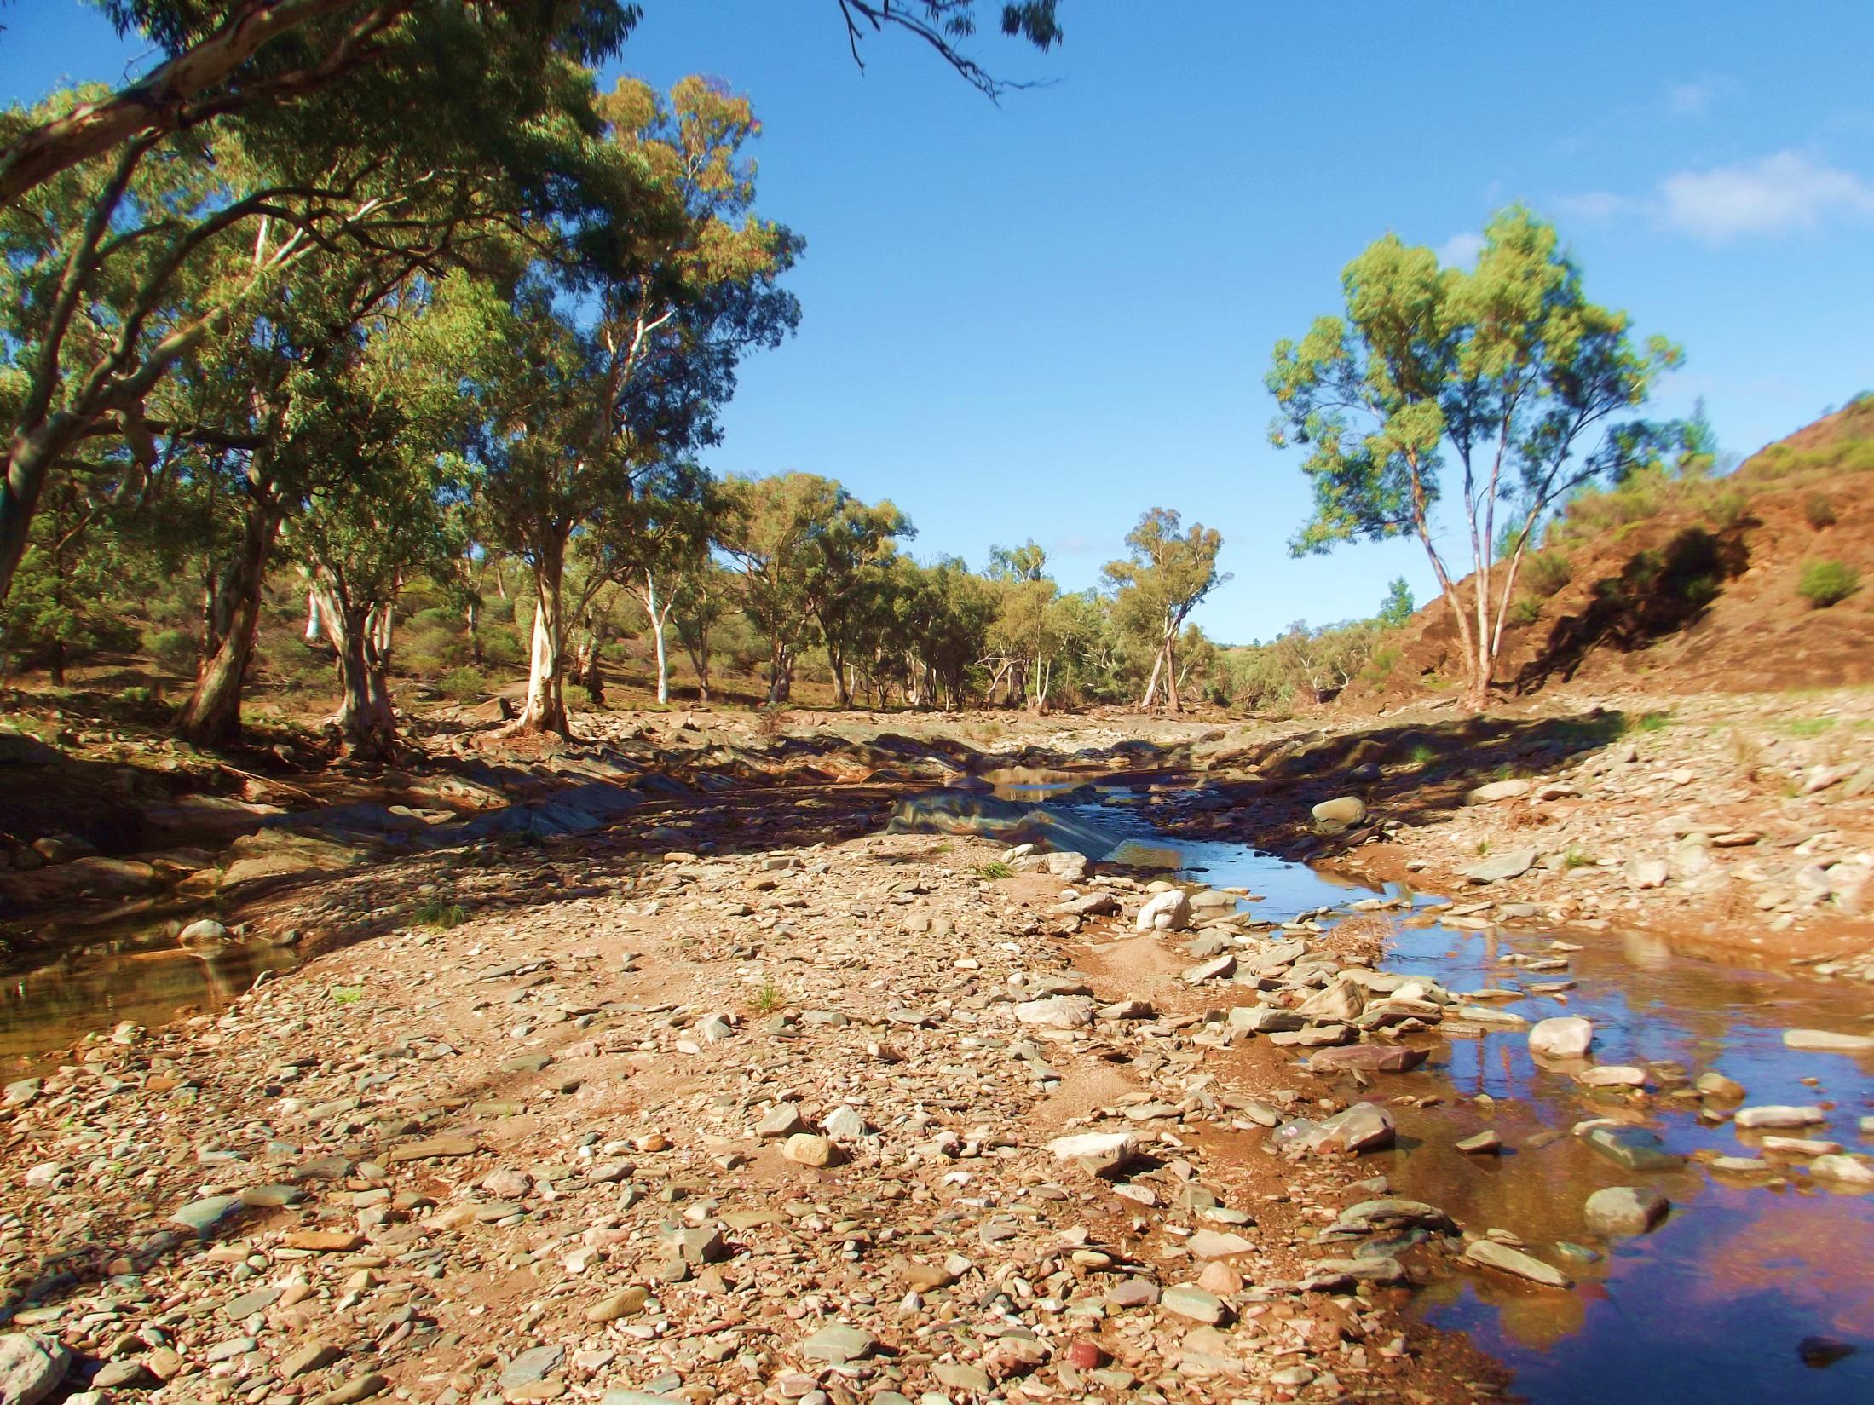
Wida Ardapa
(The Gum Tree Couple)

Slide 10
4. Some members of the uniting churches approached the First Peoples with good intentions, standing with them in the name of justice; considering their well being, culture and language as the churches proclaimed the reconciling purpose of the Triune God found in the good news about Jesus Christ.

Slide 11
5. Many in the uniting churches, however, shared the values and relationships of the emerging colonial society including paternalism and racism towards the First Peoples. They were complicit in the injustice that resulted in many of the First Peoples being dispossessed from their land, their language, their culture and spirituality, becoming strangers in their own land.

Slide 12
6. The uniting churches were largely silent as the dominant culture of Australia constructed and propagated a distorted version of history that denied this land was occupied, utilised, cultivated and harvested by these First Peoples who also had complex systems of trade and inter-relationships. As a result of this denial, relationships were broken and the very integrity of the Gospel proclaimed by the churches was diminished.

Slide 13
7. From the beginning of colonisation the First Peoples challenged their dispossession and the denial of their proper place in this land. In time this was taken up in the community, in the courts, in the parliaments, in the way history was recorded and told, and in the Uniting Church in Australia.

Slide 14
In 1985 Aboriginal and Torres Strait Islander members of the Uniting Church in Australia formed the
Uniting Aboriginal and Islander Christian Congress.

Slide 15
9. In 1988 the Uniting Aboriginal and Islander Christian Congress invited the other members of the Church to join in a solemn act of covenanting before God.

Slide 16
10. After much struggle and debate, in 1994 the Assembly of the Uniting Church in Australia discovered God's call, accepted this invitation and entered into an ever deepening covenantal relationship with the Uniting Aboriginal and Islander Christian Congress. This was so that all may see a destiny together, praying and working together for a fuller expression of our reconciliation in Jesus Christ.

Slide 17
Prayer for Reconciliation
Lord God, bring us together as one,
Reconciled with you and with each other.
You made us in your likeness.
You gave us your Son, Jesus Christ.
He has given to us forgiveness from sin.

Slide 18
Lord God, bring us together as one,
Different in culture, but given new life in Jesus Christ:
Together as your body, your church, your people.

Slide 19
Lord God, bring us together as one,
Reconciled, healed, forgiven,
Sharing you with others as you have
called us to do.
In Jesus Christ, let us be together as one.

