Slide 1
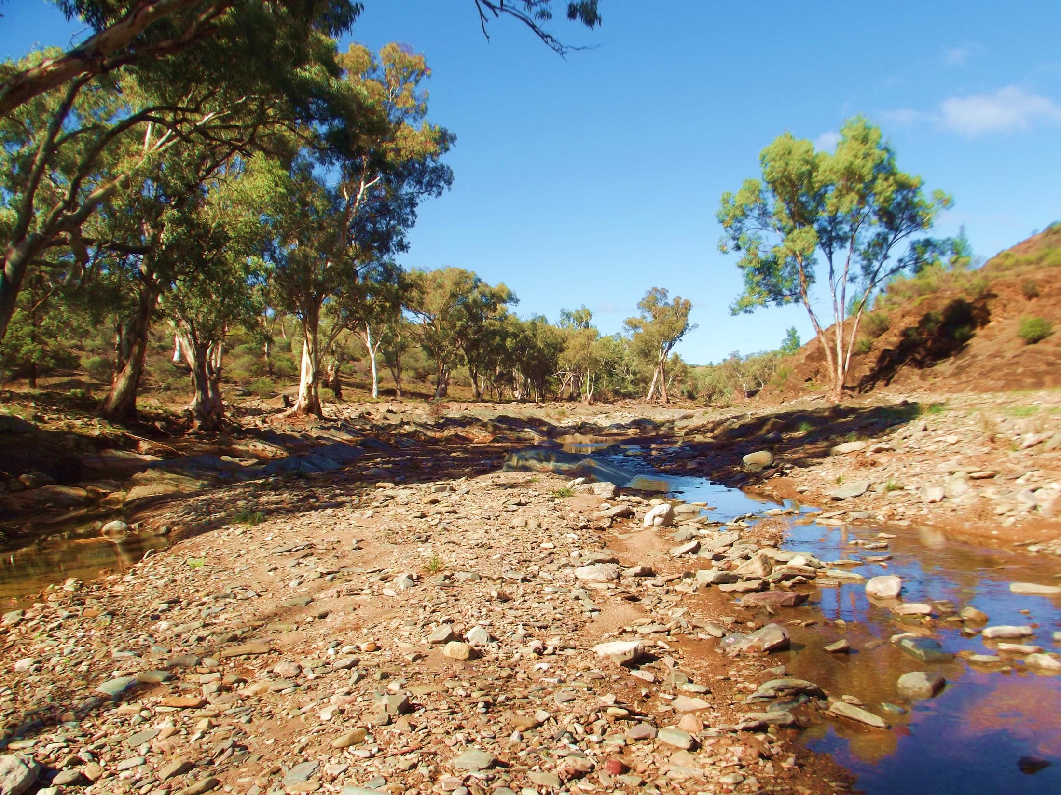
Wida Ardapa
(The Gum Tree Couple)

